Slide 1
Chat App(s)
Ibrahim Ahtsham 24224
ACP SE5-1

Slide 2
Contents
Chat App Version 1
Swing
Group Chat
Database Only
Chat App Version 2
JavaFX
Client-Server
No Database

Slide 3
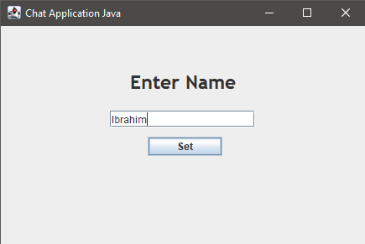
Version 1 (Making new user)
Input name
and press
set

Slide 4
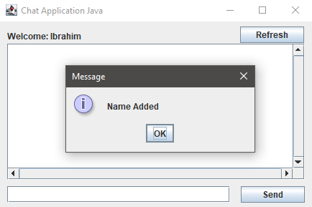
Version 1 (New User Added)
Welcome screen

Slide 5
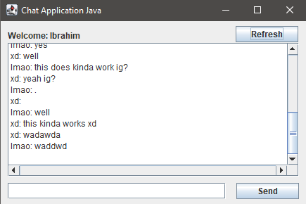
Version 1 (Previous chat loaded)
After clicking “OK” button the previous chat is loaded

Slide 6
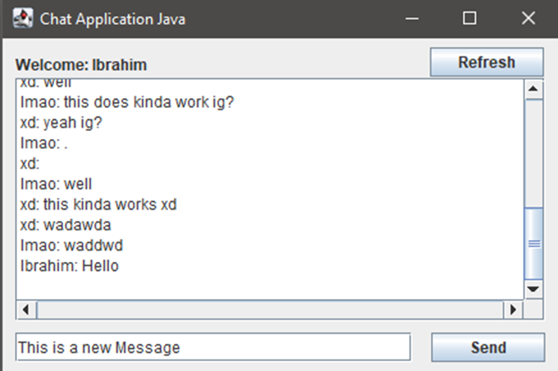
Version 1 (Typing new message)
Type new message and press send

Slide 7
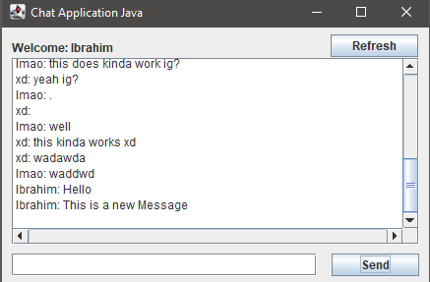
Version 1 (Message Send and added to DB)
The message has been sent and added to database

Slide 8
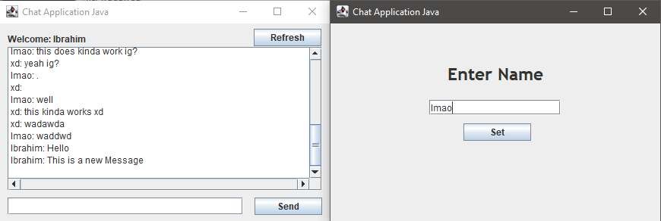
Version 1 (Logging in with existing User)
Run another instance of the same program, and set name

Slide 9
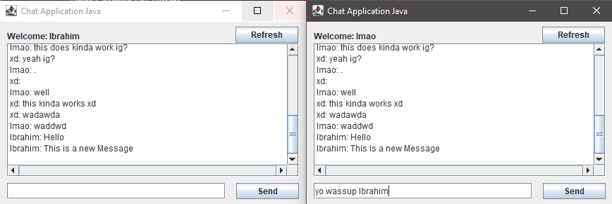
Version 1 (Logged in, sending message)
Send a message

Slide 10
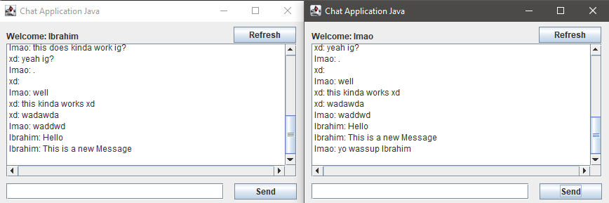
Version 1 (Message Sent, not refreshed)
Message is sent, but it does not show on “Ibrahim” instance (refresh needed)

Slide 11
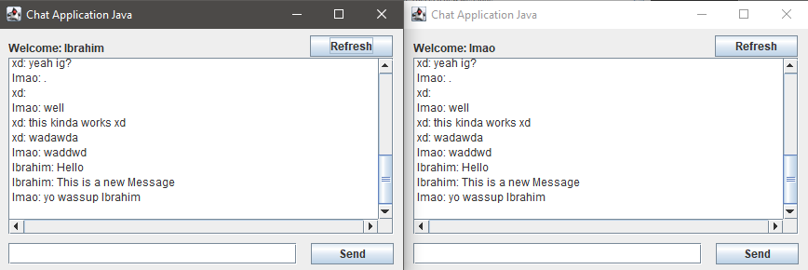
Version 1 (Message Sent, refreshed)
Click on “Refresh” button for “Ibrahim” instance

Slide 12
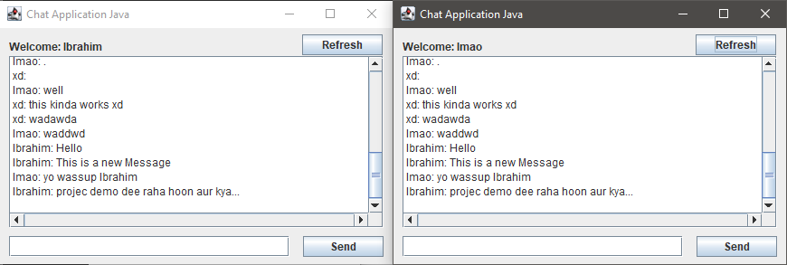
Version 1 (Reply)
Working example of a sent reply

Slide 13
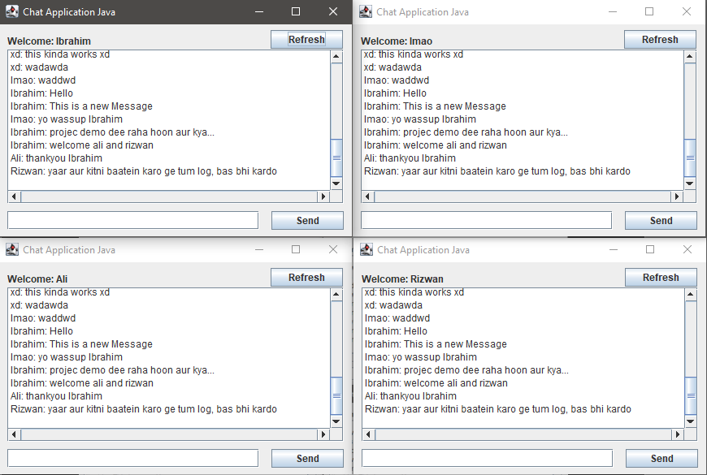
Version 1 (four instances Running at once)
4 instances ruining at once

Slide 14
Version 2 (Client-Server no database)
Working example of chat app using client-server architecture by making use of sockets and thread

Slide 15
Thankyou For Watching
Please like and subscribe

